Slide 1
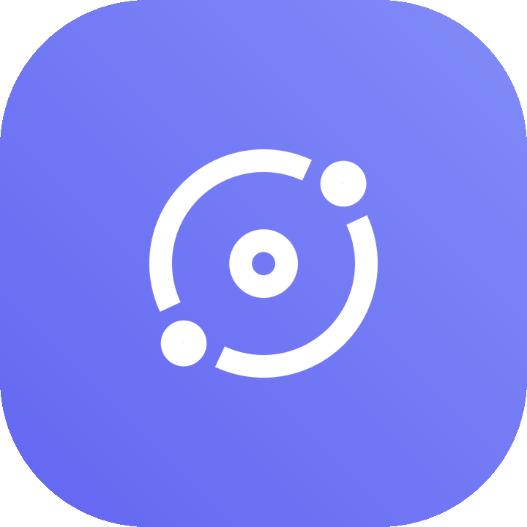
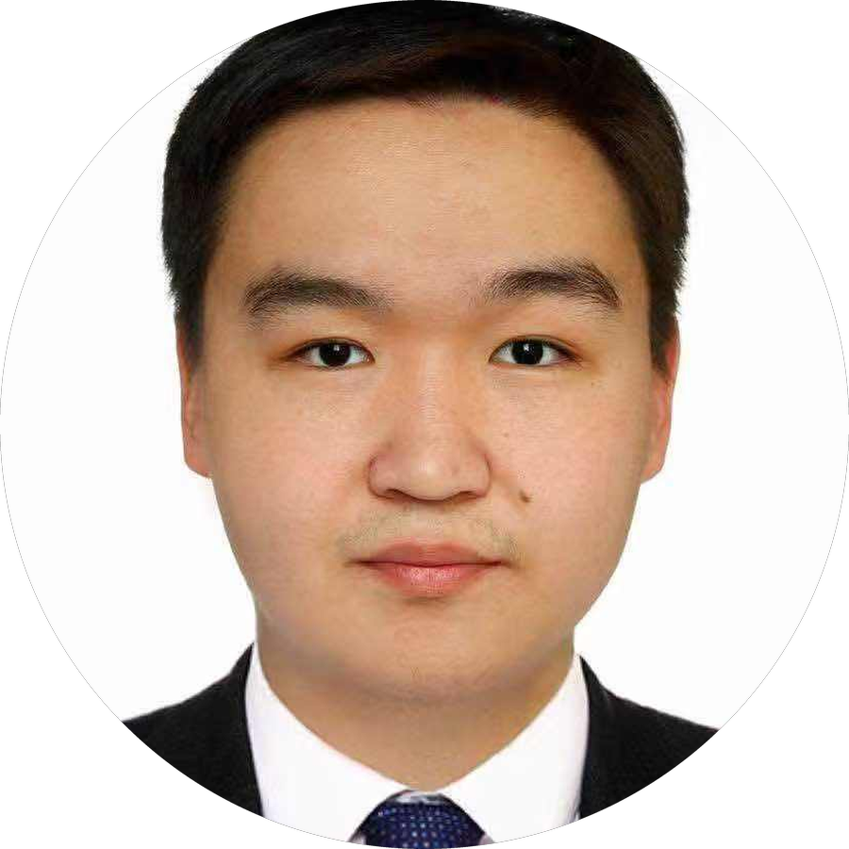
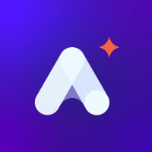
Zetwork
BUILD WITH THE RIGHT PEOPLE
A developer team-matching platform that pairs engineers by
skills, mindset & vibe — using offline ML archetypes and a
5-factor compatibility model.
Boldbaatar Bolor
Capstone Project · Cohort 2
Presented at
AI Academy Asia

Slide 2
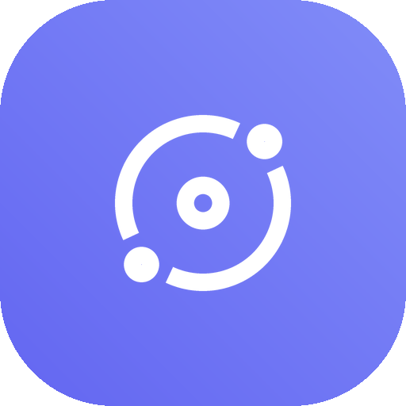
Zetwork
THE PROBLEM
Finding the right people to build with is broken
01
02
03
04
Networking is noise
Skills ≠ fit
Discovery is flat
Cold & impersonal
Job boards and LinkedIn optimise for hiring, not for finding a compatible person to actually build with.
Two great engineers can still clash. Stack overlap, working style and goals all matter — but nothing measures them together.
Endless lists and filters. There is no intuitive way to *see* who sits closest to you in skill-space.
Reaching out feels transactional. There's no shared language for “why” two developers would click.
Zetwork turns “who should I build with?” into a measurable, visual question.
Boldbaatar Bolor · Cohort 2 · AI Academy Asia
02

Slide 3
Zetwork
THE SOLUTION
A team-matching engine for developers
Zetwork profiles each developer by their languages, interests, current project and even a zodiac sign — then places them in a shared skill-space.
An offline ML model assigns one of five developer archetypes, and a transparent 5-factor score explains exactly why two people match — then lets them connect and chat.
What a user gets
Instant archetype Your profile is classified the moment you save it.
Ranked matches Everyone in the network scored 0–100 against you.
Explainable score Five bars show why — not a black box.
Constellation map See your matches as a star-field you can click.
5
71,223
5
Connect & chat Requests, accept/decline, and 1:1 messaging.
developer
archetypes
Stack Overflow
devs modelled
match factors,
fully weighted
Boldbaatar Bolor · Cohort 2 · AI Academy Asia
03

Slide 4
Zetwork
HOW IT WORKS
From profile to connection in one flow
01
02
03
04
05
Build profile
›
ML archetype
›
5-factor score
›
Constellation
›
Connect & chat
Languages, interests, a free-text build goal & zodiac sign.
PCA projection + k-Means assigns 1 of 5 archetypes.
Every other dev is scored 0–100 against you.
Matches render as a clickable 2D star-map.
Send requests, accept, and message your matches.
Runs fully offline — the ML model is pre-trained artifacts shipped with the app, so matching is instant and private.
Boldbaatar Bolor · Cohort 2 · AI Academy Asia
04

Slide 5
Zetwork
THE MODEL
Five developer archetypes
Code Architect
BACKEND & SYSTEMS
Pixel Alchemist
UI & DESIGN
Data Oracle
AI & DATA
Scalable backends, databases & system architecture.
Beautiful interfaces, animations & user experience.
Machine learning, data pipelines & predictions.
Ship-It Maverick
FAST PRODUCT BUILDER
Cyber Sentinel
DEVOPS & SECURITY
MVPs, startups, hackathons & rapid prototypes.
Servers, cloud infra & secure deployments.
Archetypes were derived by k-Means clustering + PCA over 71,223 Stack Overflow 2024 developer profiles.
Boldbaatar Bolor · Cohort 2 · AI Academy Asia
05

Slide 6
Zetwork
THE ALGORITHM
A transparent 5-factor compatibility score
Tech-stack overlap
30%
Jaccard similarity of languages & tools
Archetype fit
25%
Same or complementary archetype pairing
Interests overlap
20%
Jaccard similarity of interest tags
Zodiac harmony
15%
Fire / Earth / Air / Water element matrix
Build-goal similarity
10%
TF-IDF cosine of project descriptions
score = 0.30·tech + 0.25·archetype + 0.20·interests + 0.15·zodiac + 0.10·buildGoal → 0–100
Boldbaatar Bolor · Cohort 2 · AI Academy Asia
06

Slide 7
Zetwork
ML CORE
The data-science under the hood
PCA projection
k-Means clustering
Jaccard similarity
Each profile is reduced to 2 principal components using pre-trained keyword loadings for languages, interests & goal text.
The 2D point is assigned to its nearest of 5 archetype centroids — mirroring an offline k-Means model.
Set overlap of languages and interests gives a fast, interpretable tech-fit signal.
TF-IDF cosine
Element harmony
Weighted blend
Build-goal free text is vectorised and compared by cosine similarity (scikit-learn on the backend).
A 4×4 Fire/Earth/Air/Water matrix adds a light, fun compatibility layer.
All five signals are combined by fixed weights into one explainable 0–100 score.
Boldbaatar Bolor · Cohort 2 · AI Academy Asia
07

Slide 8
Zetwork
THE EXPERIENCE
Your matches, as a star-field
The constellation canvas plots every candidate in the same 2D skill-space as you.
compatibility map
Closer = better fit — distance encodes compatibility
Brighter = stronger — higher-scoring matches glow more
Colour = archetype — each of the 5 types has its hue
YOU
Click to inspect — opens the full match breakdown
Live filters — min-score slider & archetype filter
Boldbaatar Bolor · Cohort 2 · AI Academy Asia
08

Slide 9
Zetwork
ENGINEERING
Architecture & tech stack
Frontend
Backend
ML & Data
›
React 19 + TypeScript
›
FastAPI (Python)
›
k-Means + PCA archetypes
›
Vite 6 build tooling
›
SQLAlchemy ORM
›
71,223 SO 2024 devs
›
Tailwind CSS v4
›
PostgreSQL / SQLite
›
Offline model artifacts
›
Motion (animations)
›
JWT + bcrypt auth
›
Jaccard + cosine scoring
›
lucide-react icons
›
scikit-learn (TF-IDF)
›
5-factor weighted blend
›
Canvas constellation UI
›
Express/tsx dev server
›
Deploy-ready (AWS RDS)
Boldbaatar Bolor · Cohort 2 · AI Academy Asia
09

Slide 10
Zetwork
PRODUCT
What's built
Auth & sessions
Profile builder
Live matching
Register / login with JWT tokens, bcrypt-hashed passwords, persisted client session.
Languages, interests, build-goal and zodiac — instantly classified into an archetype.
Server-side ranking of the whole network with per-factor score breakdowns.
Constellation view
Connections
Messaging
Interactive 2D map with score slider, archetype filter and click-to-inspect.
Send / accept / decline requests with pending-in & pending-out states.
1:1 chat hub with your accepted connections and last-message previews.
Boldbaatar Bolor · Cohort 2 · AI Academy Asia
10

Slide 11
Thank you
ZETWORK · BUILD WITH THE RIGHT PEOPLE
Matching developers by skill, mindset & vibe.
Boldbaatar Bolor
Cohort 2 · AI Academy Asia

